Slide 1
SQL
Joins - Exercises

Slide 2
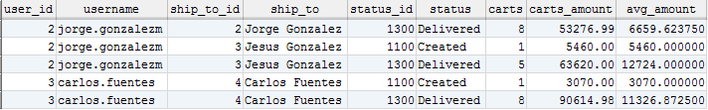
Joins - Exercises
1. Get the number of carts by ShipTo and Status, from Carts “CREATED” and “DELIVERED” and which the average of cart_amount on each group is between $ 3,000 and $ 15,000.
Include the relevant description for ShipTo and Status.
SELECT c.user_id
, u.username
, c.ship_to_id
, st.name ship_to
, c.status_id
, s.description status
, COUNT(c.cart_id) AS carts
, SUM(c.cart_amount) AS carts_amount
, AVG(c.cart_amount) AS avg_amount
FROM cart c
INNER JOIN user u
ON c.user_id = u.user_id
INNER JOIN ship_to st
ON c.ship_to_id = st.ship_to_id
INNER JOIN status s
ON c.status_id = s.status_id
WHERE c. status_id IN (1100, 1300)
GROUP BY c.ship_to_id
, c.status_id
HAVING avg_amount BETWEEN 3000 AND 15000;

Slide 3
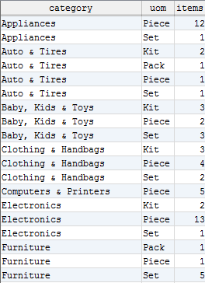
Joins - Exercises
2. Get the number of Items by Category and UnitOfMeasure.
Sort the result by Category and then by UOM.
SELECT c.description category
, uom.description uom
, COUNT(i.item_id) items
FROM category c
INNER JOIN category_item ci
ON c.category_id = ci.category_id
INNER JOIN item i
ON ci.item_id = i.item_id
INNER JOIN uom
ON I.uom_id = uom.uom_id
GROUP BY category
, uom
ORDER BY category
, uom;

Slide 4
Jorge Luis Gonzalez
jorge.gonzalezm@softtek.com
Instructor

